Slide 1
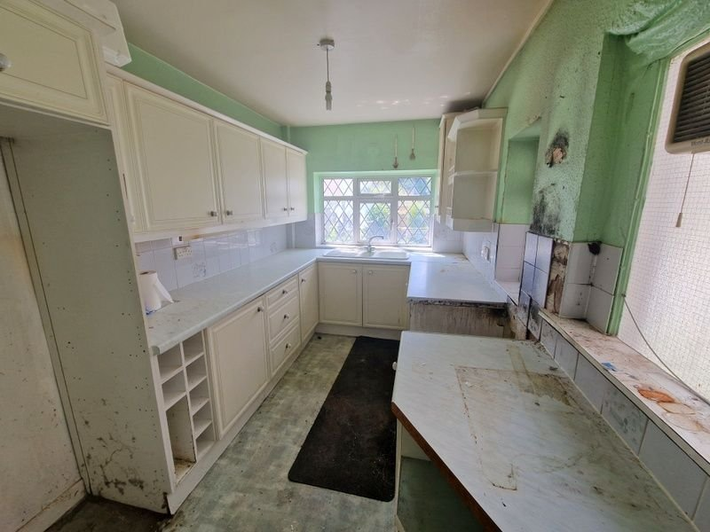
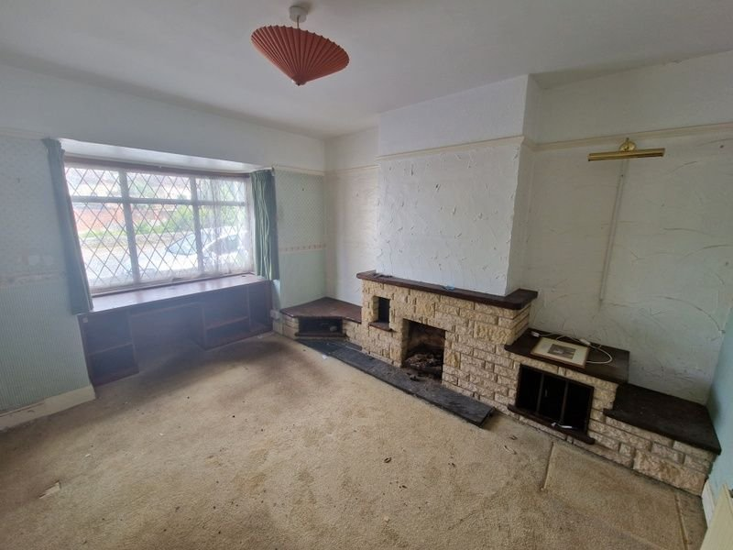
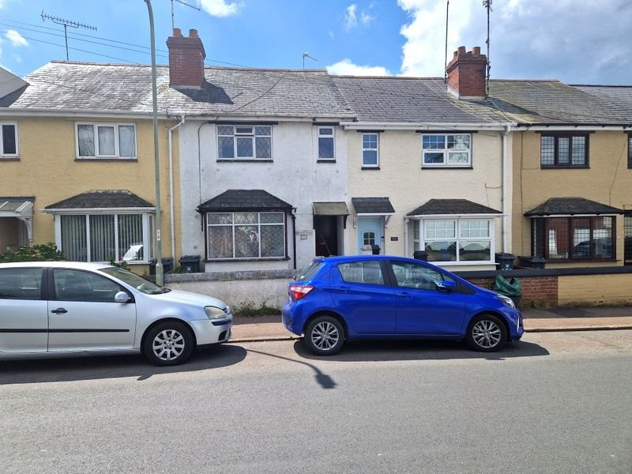
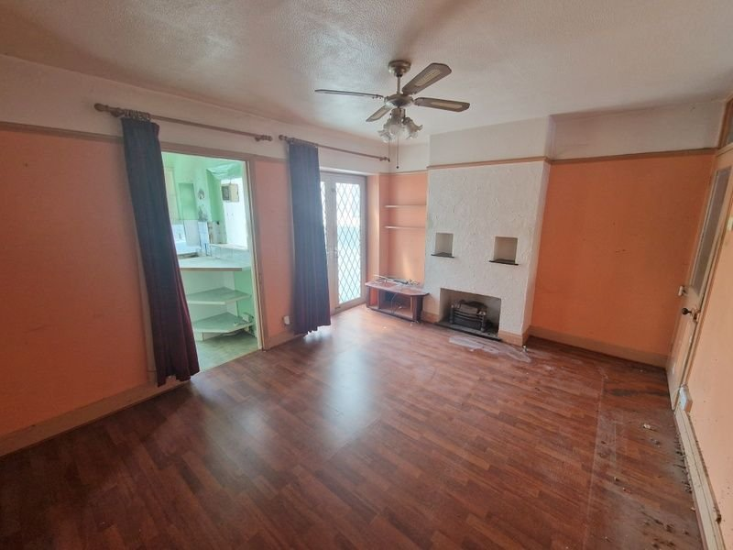
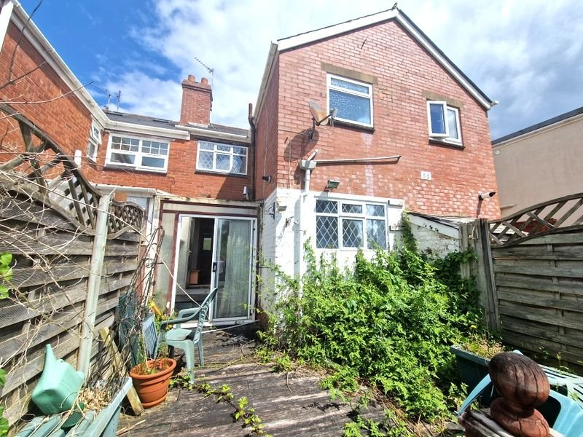
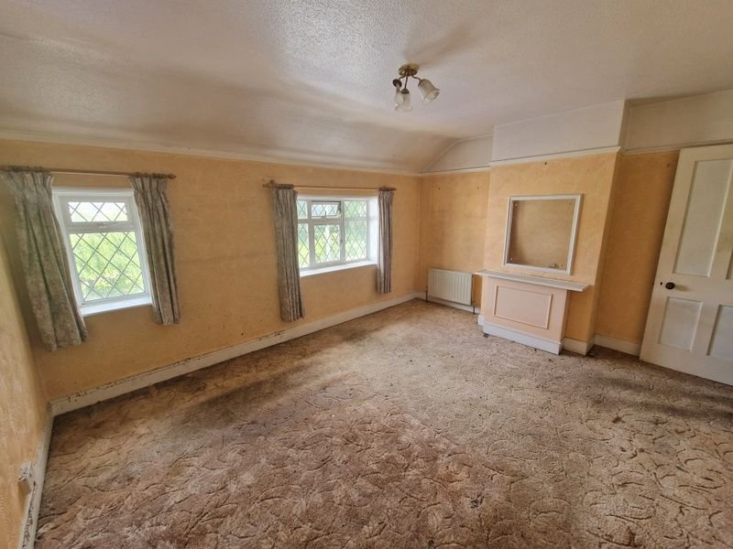
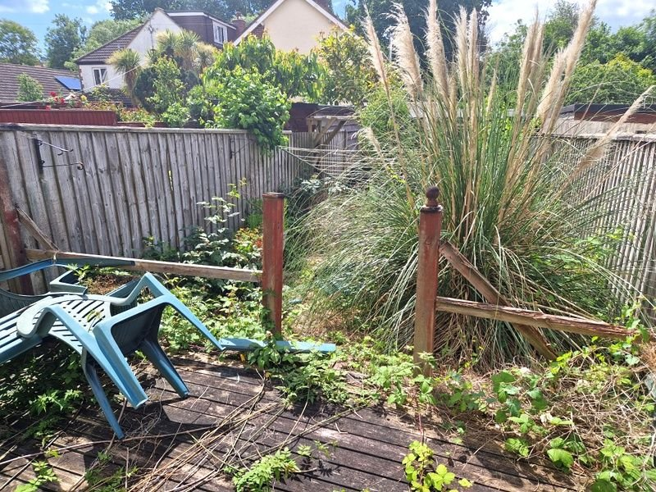
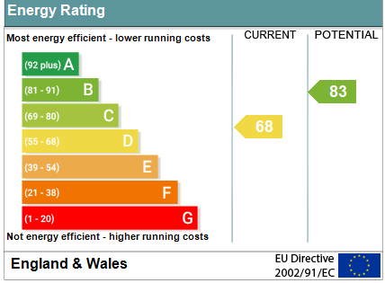
www.pennys.net
222 Withycombe Village Road, Exmouth, EX8 3BD
GUIDE PRICE £190,000
TENURE Freehold
A Period Terrace House Located In A Popular And Convenient Location To Be Sold By Traditional Online Auction At 12non On 29th July 2024
Full Program Of Modernisation And Refurbishment Required * Reception Hall * Lounge * Dining/Family Room * Garden Room * Kitchen * Two First Floor Double Bedrooms * Spacious Bathroom * Separate Wc * Good Size Enclosed Rear Garden
Pennys Estate Agents Limited for themselves and for the vendor of this property whose agents they are give notice that:- (1) These particulars do not constitute any part of an offer or a contract. (2) All statements contained in these particulars are made without responsibility on the part of Pennys Estate Agents Limited. (3) None of the statements contained in these particulars are to be relied upon as a statement or representation of fact. (4) Any intending purchaser must satisfy himself/herself by inspection or otherwise as to the correctness of each of the statements contained in these particulars. (5) The vendor does not make or give and neither do Pennys Estate Agents Limited nor any person in their employment has any authority to make or give any representation or warranty whatever in relation to this property.
PENNYS ESTATE AGENTS
2 Rolle House, Rolle Street, Exmouth, Devon, EX8 2SN
Tel: 01395 264111 EMail: help@pennys.net

Slide 2
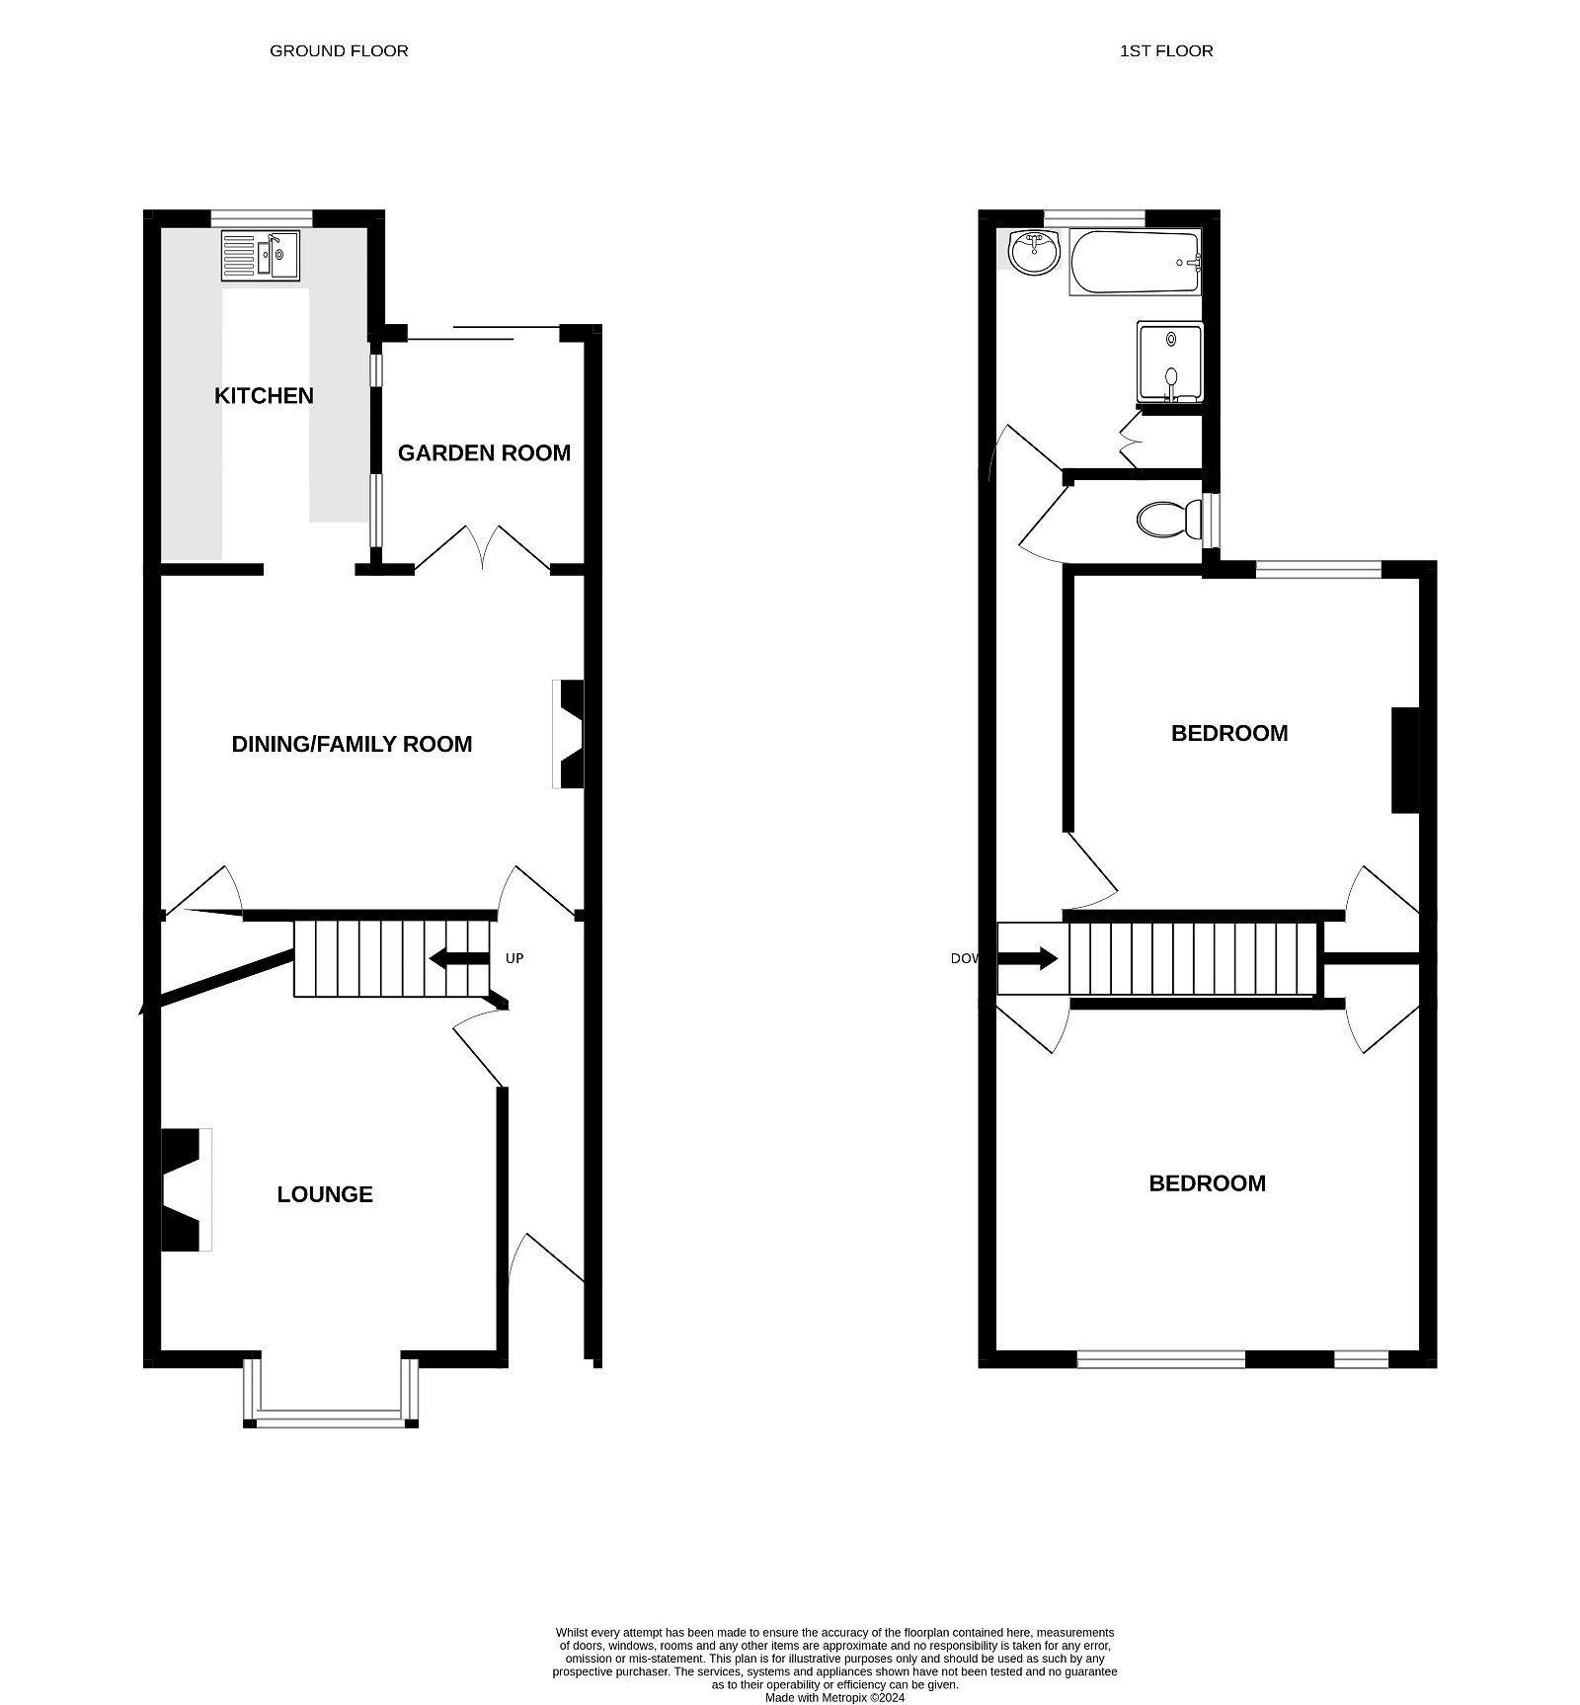
222 Withycombe Village Road, Exmouth, EX8 3BD
THE ACCOMMODATION COMPRISES: Open entrance porch with front door leading to:
RECEPTION HALL: Radiator, stairs to first floor landing.
LOUNGE: 3.66m x 3.3m (12'0" x 10'10") Square bay window overlooking the front aspect, stone fireplace and display areas, radiator.
DINING/FAMILY ROOM: 4.47m x 3.35m (14'8" x 11'0") With double doors opening onto the garden room, chimney recess, understair storage cupboard, radiator.
GARDEN ROOM: 2.34m x 1.96m (7'8" x 6'5") With sliding double doors to garden.
KITCHEN: 3.51m x 2.21m (11'6" x 7'3") Fitted with worktops and cupboards and drawers beneath, wall mounted cupboards, sink unit, radiator and two windows.
FIRST FLOOR LANDING: With access to roof space.
BEDROOM 1: 4.34m x 3.66m (14'3" x 12'0") With two windows to front aspect, fitted cupboard, two radiators.
BEDROOM 2: 3.43m x 3.35m (11'3" x 11'0") With radiator, window to rear aspect, fitted cupboard.
BATHROOM: 2.59m x 2.24m (8'6" x 7'4") With bath and shower cubicle, vanity wash hand basin, airing cupboard housing water cylinder, window to rear aspect.
SEPARATE WC:
OUTSIDE: To the front of the property is a small garden enclosure with pedestrian gate giving access to the property. To the rear of the property is a good size fully enclosed rear garden.
IMPORTANT AUCTION INFORMATION: All lots are sold subject to the Common Auction Conditions and Special Conditions of Sale (unless varied by the Sellers Solicitors), together with the Addendum (if applicable), which will be available on Auction Day.
AUCTION LEGAL PACK & FINANCE: Copies of the legal pack and special conditions of sale are available online to be downloaded, via the tab on the online auction property listing page. It is the purchaser's responsibility to make all necessary legal, planning and finance enquiries prior to the auction.
PRICE INFORMATION: Guides are provided as an indication of each Seller's minimum expectation. They are not necessarily figures at which a property will sell for and may change at any time prior to Auction. Unless stated otherwise, each Lot will be offered subject to a reserve price (a figure below which the Auctioneer cannot sell the Lot during the Auction). This reserve figure cannot be higher than 10% above a single figure guide. Please check our website regularly at www.247propertyauctions.co.uk or contact us on 01395 247000 for up to date information. Following the fall of the hammer contracts are exchanged and there is no going back!
AUCTION INFORMATION: Traditional auction Exchange occurs at the end of the auction. This means that if the reserve is met or exceeded and the auction timer reaches zero, the successful bidder is legally obliged to pay the purchase price and the seller will be legally obliged to sell the property. To ensure that the successful bidder proceeds, the buyer is automatically charged a holding deposit, which is held in a secure client account, pursuant to the terms of a holding deposit agreement. Pricing information The Guide Price amount specified is an indication of each seller's minimum expectation. It is not necessarily the amount at which the property will sell. Each property will be offered subject to a Reserve (a figure below which the property will not be sold) which we expect will be set no more than 10% above the Guide Price amount. Bamboo Auctions and 247 Property Auctions shall not be liable for any inaccuracies in the fees stated on this description page, in the bidding confirmation pop up or in the particulars. Buyers should check the contents of the legal pack and special conditions for accurate information on fees. Where there is a conflict between the fees stated in the particulars, the bid information box above or the bidding confirmation pop up and the contents of the legal pack, the contents of the legal pack shall prevail. Stamp Duty Land Tax or Land and Buildings Transaction Tax may also apply in some circumstances. Refreshing the page To make sure that you are seeing the latest information for the property, we recommend you refresh the page. This ensures you're seeing live information and not stored (cached) data. If the page disconnects from the Internet, refreshing the page will show the latest information. Disclaimer All information relating to this property, including descriptions, pictures and other related information has been provided by 247 Property Auctions. All legal documents in relation to this property have been provided by the Vendor's solicitor. Neither Bamboo Auctions or any individual in employment with Bamboo Auctions makes any warranty as to the accuracy or completeness of any of the property information. These particulars do not form part of any contract or offer. Buyers should not rely on them as statements of representation and should check that the information is correct by inspection or otherwise. Where there is a conflict between the contents of the legal documents and these particulars, the information contained in the legal documents shall prevail.
FLOOR PLAN:

